Slide 1

Managing Non-Traditional Software Teams
Presented by:
Thoa Le

Slide 2
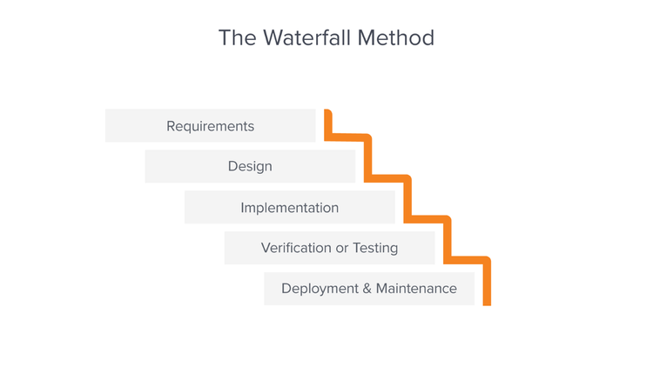
Traditional
Agile
Developed in 1970s
Linear Approach
Complete project scope known (Costs, Timeframe, Requirements)
Developed in 2000s
Iterative Approach
Components of project worked on individually

Slide 3
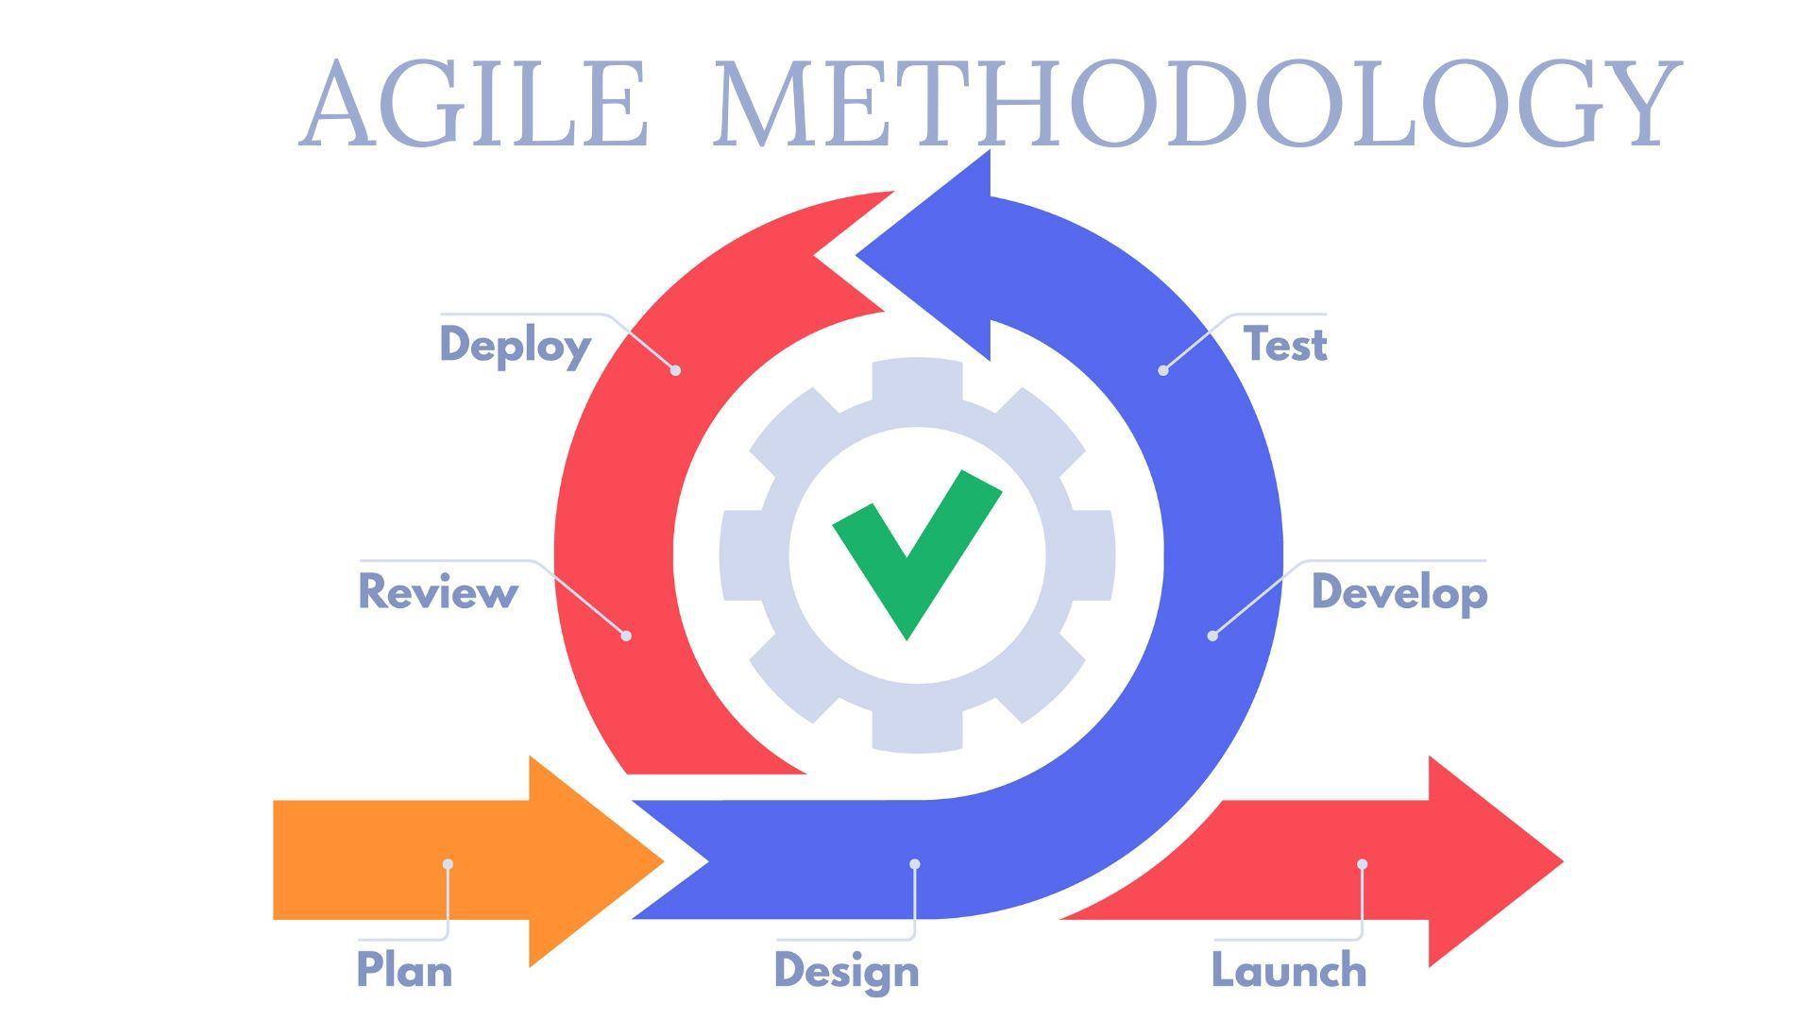
Advantages of Agile
Customer Satisfaction
Cross-Functional Teams
Flexible and Adaptive

Slide 4
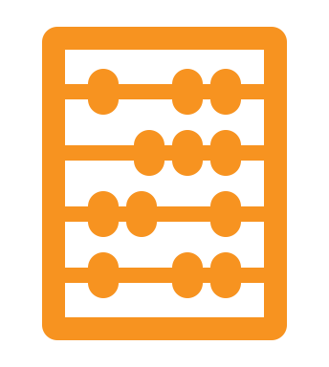

Agile-Based Software
Trello
User friendly tool with a focus on simplicity and flexibility
Designed to be useful in collaboration
Uses Kanban framework (visuals)
Udemy, Stack Overflow
Jira
More complex than Trello
Focuses on documentation, such as issue tracking and change logs
Can use either Scrum (sprints) or Kanban framework
Capital One, LinkedIn

Slide 5


Summary
Agile vs Traditional
Advantages of Agile
Agile-based Software

Slide 6
Questions?

Slide 7
References
https://www.amplifyre.com/articles/agile-methodology-for-software-development
https://business.adobe.com/blog/basics/waterfall
https://www.knowledgehut.com/blog/agile/agile-project-management-vs-traditional-project-management
https://technologyadvice.com/blog/information-technology/trello-vs-jira-choosing-an-agile-project-management-tool/#:~:text=Trello%20remains%20the%20lightweight%2C%20kanban,the%20best%20fit%20for%20everyone.

